Slide 1

Full stack diploma
HTML5

Slide 2

What is HTML5?
HTML is referred to as the primary language of the World Wide Web. HTML has many updates over time, and the latest HTML version is HTML5. HTML5 is a new version of HTML with new functionalities with markup language with Internet technologies
V 2.0

Slide 3
What is are the differences between HTML and HTML5?
Feature | HTML | HTML5
Multimedia support | Language in HTML does not have support for video and audio. | HTML5 supports both video and audio
Doc type | Doctype declaration in html is too long <! DOCTYPE HTML PUBLIC "- // W3C // DTD HTML 4.01 // EN" "http://www.w3.org/TR/html4/strict.dtd"> | The DOCTYPE declaration in html5 is very simple "<! DOCTYPE html>
V 2.0

Slide 4
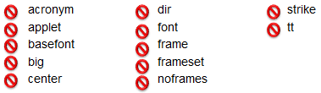
What is are the differences between HTML and HTML5?
You can read more about the difference between HTML and HTML5 in:
https://www.geeksforgeeks.org/difference-between-html-and-html5/
There was some tags in HTML which are no longer exists in HTML5 like:
V 2.0

Slide 5
HTML Tags
Head
The <head> element is a container for metadata (data about data) and is placed between the <html> tag and the <body> tag.
Metadata is data about the HTML document. Metadata is not displayed.
Metadata typically define the document title, character set, styles, scripts, and other meta information.
V 2.0

Slide 6
HTML Tags
Head
The following elements can go inside the <head> element:
<title> (required in every HTML document)
<style>
<base>
<link>
<meta>
V 2.0

Slide 7
HTML Tags
Head
<title> (required in every HTML document)
The contents of a page title is very important for search engine optimization (SEO)! The page title is used by search engine algorithms to decide the order when listing pages in search results.
The <title> element:
defines a title in the browser toolbar
provides a title for the page when it is added to favorites
displays a title for the page in search-engine results
V 2.0

Slide 8
HTML Tags
Head
<style>
The <style> tag is used to define style information (CSS) for a document.
Inside the <style> element you specify how HTML elements should render in a browser.
V 2.0

Slide 9
HTML Tags
Head
<base>
The <base> tag specifies the base URL and/or target for all relative URLs in a document.
The <base> tag must have either an href or a target attribute present, or both.
There can only be one single <base> element in a document, and it must be inside the <head> element.
V 2.0

Slide 10
HTML Tags
Head
<link>
The <link> tag defines the relationship between the current document and an external resource.
The <link> tag is most often used to link to external style sheets.
The <link> element is an empty element, it contains attributes only.
V 2.0

Slide 11
HTML Tags
Head
<meta>
The <meta> tag defines metadata about an HTML document. Metadata is data (information) about data.
<meta> tags always go inside the <head> element, and are typically used to specify character set, page description, keywords, author of the document, and viewport settings.
Metadata will not be displayed on the page, but is machine parsable.
Metadata is used by browsers (how to display content or reload page), search engines (keywords), and other web services.
V 2.0

Slide 12
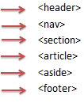
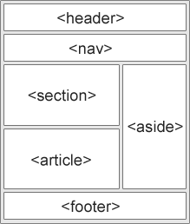
HTML Tags
Symantec tags
In HTML there are some semantic elements that can be used to define different parts of a web page:
V 2.0

Slide 13
HTML Tags
Header
Represents a group of introductory or navigational aids.
A <header> element typically contains:
one or more heading elements (<h1> - <h6>)
logo or icon
authorship information
V 2.0

Slide 14
HTML Tags
Nav
The <nav> tag defines a set of navigation links.
NOT all links of a document should be inside a <nav> element. The <nav> element is intended only for major block of navigation links.
Note
V 2.0

Slide 15
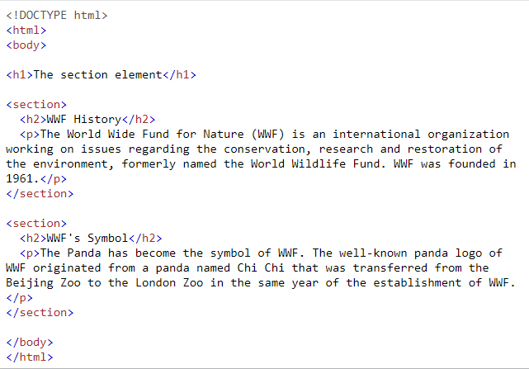
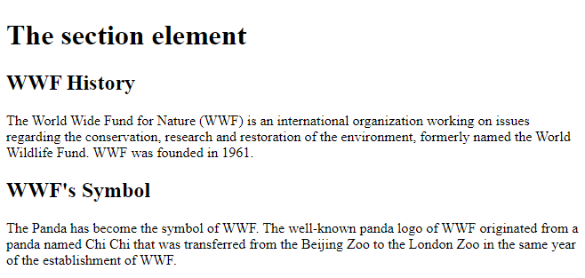
HTML Tags
Section
The <section> tag defines a section in a document.
V 2.0

Slide 16
HTML Tags
Article
The <article> tag specifies independent, self-contained content.
An article should make sense on its own and it should be possible to distribute it independently from the rest of the site.
Potential sources for the <article> element:
Forum post
Blog post
News story
V 2.0

Slide 17
HTML Tags
Aside
The <aside> tag defines some content aside from the content it is placed in.
The aside content should be indirectly related to the surrounding content.
Tip: The <aside> content is often placed as a sidebar in a document.
V 2.0

Slide 18
HTML Tags
Footer
The <footer> tag defines a footer for a document or section..
A <footer> element typically contains:
authorship information
copyright information
contact information
sitemap
back to top links
related documents
V 2.0

Slide 19
HTML Tags
Body
The <body> tag defines the document's body.
The <body> element contains all the contents of an HTML document, such as headings, paragraphs, images, hyperlinks, tables, lists, etc.
Note: There can only be one <body> element in an HTML document.
V 2.0

Slide 20
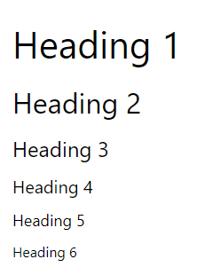
HTML Tags
Headings
HTML headings are defined with the <h1> to <h6> tags.
<h1> defines the most important heading. <h6> defines the least important heading. Search engines use the headings to index the structure and content of your web pages.
Users often skim a page by its headings. It is important to use headings to show the document structure.
<h1> headings should be used for main headings, followed by <h2> headings, then the less important <h3>, and so on.
Importance of headings
V 2.0

Slide 21
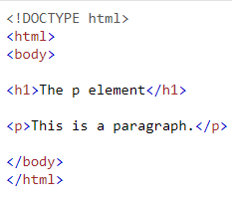
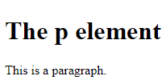
HTML Tags
Paragraphs
The <p> tag defines a paragraph.
V 2.0

Slide 22
HTML Tags
Lists
Ordered List: An ordered list starts with the <ol> tag. Each list item starts with the <li> tag.
<ol> <li>Coffee</li> </ol>
Lists: An unordered list starts with the <ul> tag. Each list item starts with the <li> tag.
<ul> <li>Coffee</li> </ul>
V 2.0

Slide 23
HTML Tags
Video
To show a video in HTML, use the <video> element:
The <source> element allows you to specify alternative video files which the browser may choose from.
It is a good idea to always include width and height attributes
<video width="320" height="240" controls> <source src="movie.mp4" type="video/mp4"> </video>
V 2.0

Slide 24
HTML Tags
Audio
To play an audio file in HTML, use the <audio> element:
<audio controls> <source src="horse.ogg" type="audio/ogg"> </audio>
V 2.0
V 2.0
V 2.0

Slide 25
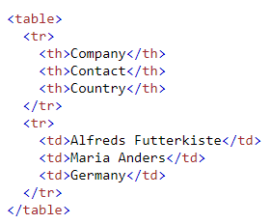

HTML Tags
Table
A table in HTML consists of table cells inside rows and columns
Table Cells: Each table cell is defined by a <td> and a </td> tag.
Table Rows: Each table row starts with a <tr> and end with a </tr> tag.
Table Headers: Sometimes you want your cells to be headers, in those cases use the <th> tag instead of the <td> tag
V 2.0

Slide 26
HTML Tags
Form Attribute
Action: The action attribute defines the action to be performed when the form is submitted.
Usually, the form data is sent to a file on the server when the user clicks on the submit button
Method: The method attribute specifies the HTTP method to be used when submitting the form data.
The form-data can be sent as URL variables (with method="get") or as HTTP post transaction (with method="post").
Target: The target attribute specifies where to display the response that is received after submitting the form
V 2.0

Slide 27
HTML Tags
Form Elements
Inputs:
One of the most used form element is the <input> element.
The <input> element can be displayed in several ways, depending on the type attribute.
V 2.0

Slide 28
HTML Tags
Form Elements
Label:
The <label> element defines a label for several form elements.
The <label> element is useful for screen-reader users, because the screen-reader will read out loud the label when the user focus on the input element.
V 2.0

Slide 29
HTML Tags
Form Elements
Textarea:
The <textarea> element defines a multi-line input field (a text area)
We define rows and cols in textarea:
The rows attribute specifies the visible number of lines in a text area.
The cols attribute specifies the visible width of a text area.
V 2.0

Slide 30
HTML Tags
Form Elements
Button:
The <button> element defines a clickable button.
Always specify the type attribute for the button element. Different browsers may use different default types for the button element.
V 2.0

Slide 31
HTML Tags
Form Elements
Datalist:
The <datalist> element specifies a list of pre-defined options for an <input> element.
Users will see a drop-down list of the pre-defined options as they input data.
The list attribute of the <input> element, must refer to the id attribute of the <datalist> element.
V 2.0

Slide 32


HTML Tags
Input Types
Text
defines a single-line text input field
V 2.0

Slide 33


HTML Tags
Input Types
Password
defines a password field
V 2.0

Slide 34
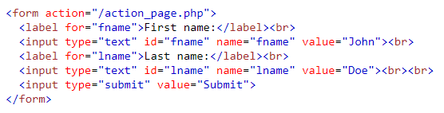
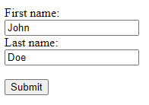
HTML Tags
Input Types
Submit
defines a button for submitting form data to a form-handler
V 2.0

Slide 35
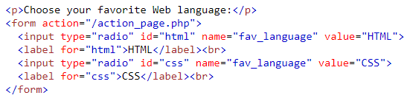

HTML Tags
Input Types
Radio
Radio buttons let a user select ONLY ONE of a limited number of choices
V 2.0

Slide 36
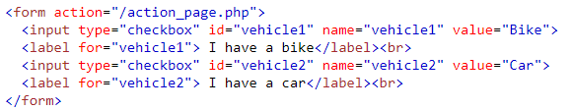

HTML Tags
Input Types
Checkbox
Checkboxes let a user select ZERO or MORE options
V 2.0

Slide 37

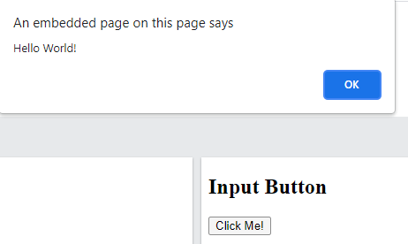
HTML Tags
Input Types
Button
defines a button
V 2.0

Slide 38


HTML Tags
Input Types
Color
is used for input fields that should contain a color
V 2.0

Slide 39
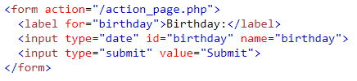

HTML Tags
Input Types
Data
is used for input fields that should contain a date
V 2.0

Slide 40
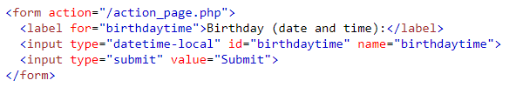
HTML Tags
Input Types
Datatime-local
The <input type="datetime-local"> specifies a date and time input field, with no time zone
V 2.0

Slide 41


HTML Tags
Input Types
Email
is used for input fields that should contain an e-mail address
V 2.0

Slide 42
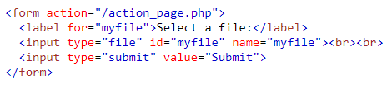

HTML Tags
Input Types
File
defines a file-select field and a "Browse" button for file uploads
V 2.0

Slide 43
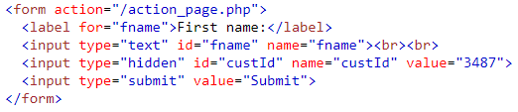

HTML Tags
Input Types
Hidden
defines a hidden input field (not visible to a user)
V 2.0

Slide 44


HTML Tags
Input Types
Month
allows the user to select a month and year.
V 2.0

Slide 45


HTML Tags
Input Types
Number
defines a numeric input field
V 2.0

Slide 46


HTML Tags
Input Types
Search
is used for search fields (a search field behaves like a regular text field)
V 2.0

Slide 47
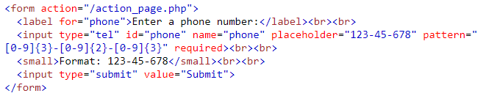
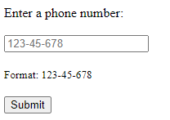
HTML Tags
Input Types
Tel
is used for input fields that should contain a telephone number
V 2.0

Slide 48
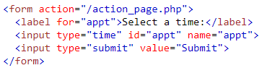

HTML Tags
Input Types
Time
allows the user to select a time (no time zone)
V 2.0

Slide 49


HTML Tags
Input Types
URL
is used for input fields that should contain a URL address.
V 2.0

Slide 50
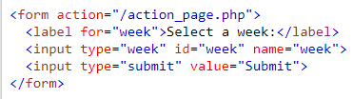

HTML Tags
Input Types
Week
allows the user to select a week and year
V 2.0

Slide 51
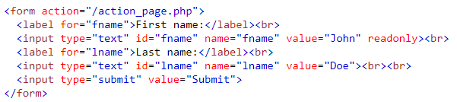
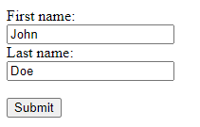
HTML Tags
Input Types
Readonly
attribute specifies that an input field is read-only
V 2.0

Slide 52
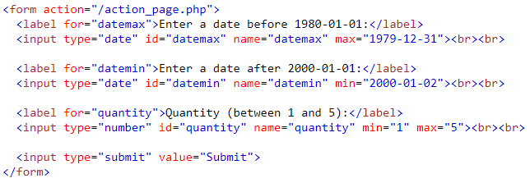
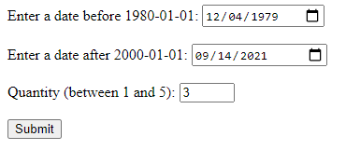
HTML Tags
Input Types
Min, Max
attributes specify the minimum and maximum values for an input field
V 2.0

Slide 53
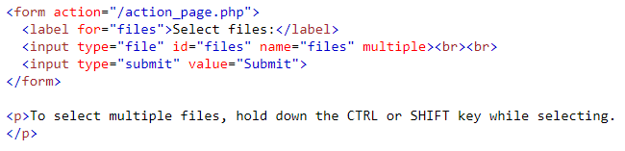
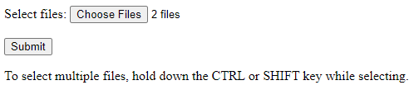
HTML Tags
Input Types
Multiple
attribute specifies that the user is allowed to enter more than one value in an input field
V 2.0

Slide 54
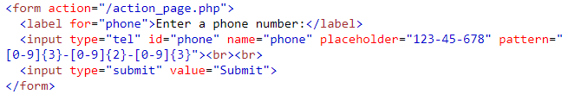

HTML Tags
Input Types
Placeholder
attribute specifies a short hint that describes the expected value of an input field
V 2.0

Slide 55
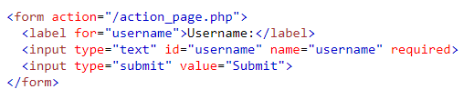

HTML Tags
Input Types
Required
attribute specifies that an input field must be filled out before submitting the form
V 2.0

Slide 56
Thank You!

